Slide 1

Ag Situation and Outlook
By
Bill Knudson

Slide 2
Topics Covered
Current Situation
Farm Bill
Energy Bill
Foreign Demand/Exchange Rates
Structural Issues
Warnings

Slide 3
What is Driving the Boom in Agriculture
Alternative Energy – ethanol
Growing incomes and standards of living throughout the world
- While less often discussed growing incomes and rising standards of living probably have a greater impact on commodity prices than alternative energy

Slide 4
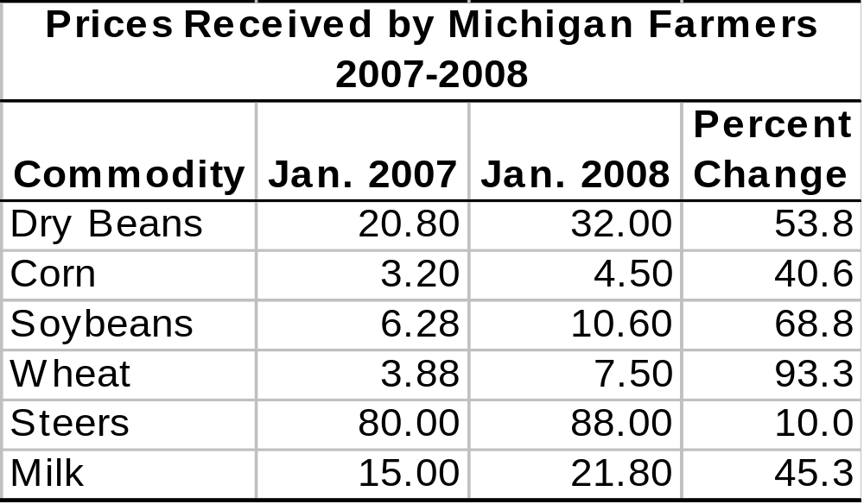
Prices are Way Up

Slide 5
High Prices are Occurring Despite Big Crops
2007 Corn crop the biggest ever despite poor weather
U.S. wheat crop was good but global output was hurt by drought
Global soybean production was strong and is likely to be strong in 2008
U.S. dairy prices highest on record in 2007

Slide 6
What is Happening
Input Costs are Rising
- From Oct. 1 2006, to Oct. 1 2007, farmland prices increased by 10 percent in Michigan. Farm land prices have increased 20 years in a row
Cash Rents are rising. Well over $100 an acre for tiled crop land $150 an acre for irrigated land in Southern Lower Peninsula

Slide 7
Other Inputs
Fertilizer
Up well over 10 percent from the previous year
Seed prices are also up and some varieties are not available
Fuel prices are up as well

Slide 8
Implications
A decline in the value of the U.S. dollar has made U.S. farm products less expensive in the world market but has increased the price of imported inputs, especially fertilizer
If you own your land you are in good shape, if you don’t you may not be better off

Slide 9
Exchange Rates
The value of the U.S. dollar has declined relative to other countries
This has several impacts on the Farm Sector
Exports become cheaper
Imported inputs (esp. fertilizer) becomes more expensive
Global competitiveness is improved

Slide 10
Farm Wealth
The Equity Position of Farmers has improved
Farmers who own land are wealthier, farmers who rent may or may not be better off
A Decline in interest rates has made borrowing more attractive but will the high prices last?

Slide 11
2007 (now 2008) Farm Bill
Currently in Conference Committee, final form likely to come in March.
More likely to be evolutionary rather than revolutionary
High commodity prices have reduced pressure on having the Farm Bill passed

Slide 12
Commodity Programs
Loan Rates and Target Prices are not likely to change much from the 2002 Farm Bill
Given current prices government programs and payments will not have a big impact on the farm sector

Slide 13
Specialty Crops (Fruits and Vegetables)
The Farm Bill does provide funding for state level research and marketing programs for fruits and vegetables
Additional funding is provided for purchases of fruits and vegetables for nutritional programs

Slide 14
COOL (Country of Origin Labeling)
House version of Farm Bill includes language on COOL
- U.S. country of origin animals spent entire life in U.S.
Mixed Origin animals that were born, or raised, or slaughtered in other countries, other countries must be labeled
Imported meat, meat from animals that spent none of their time in the U.S.
Senate Version includes chicken as well a beef and pork

Slide 15
Energy Bill
Also has a major impact on the Farm Sector
Traditional Ethanol Production to increase from 9.0 billon gallons in 2008 to 15 billion gallons by 2015. This represents approximately 3.2 billion bushels in 2008 and 5.4 billion bushels in 2015.
Could be 1/3 of the corn crop by 2015 unless new varieties dramatically increase output.

Slide 16
Expanded Ethanol Production has Driven up the Price of Other Crops
Increased acres for corn production has reduced the supply of wheat and soybeans driving up their prices
High corn prices have also slowed the rate of investment in ethanol plants

Slide 17
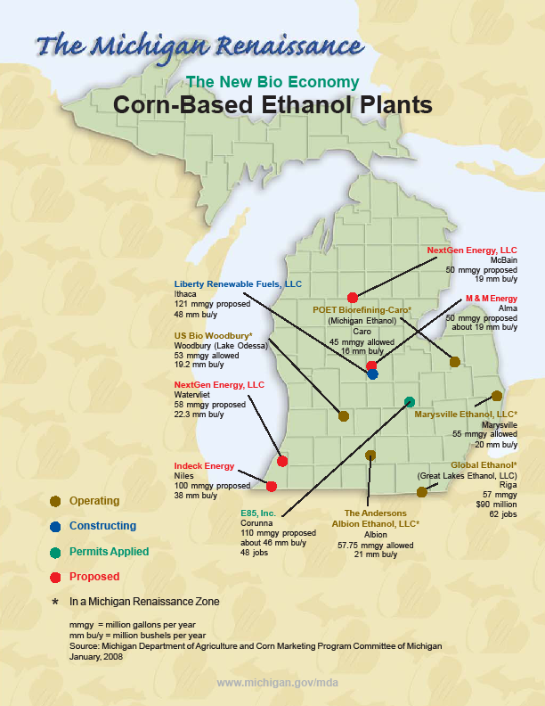

Slide 18
Food Vs. Fuel
The use of corn for ethanol has lead some to question the use of corn as a fuel source
While the use of corn for fuel has added to the rising cost of food it is a relatively small cause of rising food prices
Farmers produce food ingredients, not food

Slide 19
Rising Crop Prices do Affect Others in the Food System
The profit margins of food processors and retailers have been squeezed as a result of higher crop prices
The future is uncertain for livestock producers prices are high by historical standards but so are feed prices
Smithfield foods is reducing is sow herd by 4 to 5 percent

Slide 20
Rising Food Demand from Other Countries
Last year virtually every country in the world had positive economic growth
China up 11.5 percent in 2007 estimated 9.9 percent in 2008
India up 7.9 percent in 2007 estimated 7.7 percent in 2008
Egypt 7.1 percent in 2007 estimated 7.3 percent in 2008 (source The Economist)

Slide 21
Economic Growth Means More Food Demand
Generally only true for less developed countries
One of the first things people do when they have some disposable income is substitute animal protein for plant protein (India an exception?)
This has probably had a bigger impact on food and commodity prices than ethanol

Slide 22
Fundamental Attributes of the Farm Sector (from Schweikhardt)
People eat pretty much the same amount no matter what the price of food
People eat pretty much the same no matter what their income especially in developed economies
Farmers around the world respond to price changes

Slide 23
Asset Fixity
Assets once invested in agriculture tend to stay in agriculture
If prices decline there is a potential for dramatic losses in the ag sector, large price declines with little short term reduction in supply

Slide 24
Aspects of the Energy Market
Very similar to agriculture
In the short term changes in price lead to small changes in the amount used
Supply is also restricted in the short run
Asset fixity
Large price fluctuations are possible

Slide 25
Implications
Since the energy market and the agricultural commodity market have similar attributes
Price fluctuations are likely to be worse
Similar situation to the 1970s
Collapse of farm sector similar to the 1980s?

Slide 26
Other Pitfalls
Global economic slowdown
Could reduce demand for animal based protein
This would reduce both the demand for meat and dairy products and feed grains

Slide 27
Conclusion
In agriculture high prices cure high prices
There will be a global response to high prices which will eventually increase supplies (due to new investment and technological advances)
Traditionally short periods of high prices lead to prolonged periods of low prices

Slide 28
Conclusion
Now may be a better time to further strengthen the balance sheet and improve equity rather than taking additional loans despite low interest rates

